Slide 1
📱 Digital Marketing: Building Your Online Presence
Welcome! Let's dive into the exciting world of digital marketing and how it can power your business.

Slide 2
Building Brand Awareness
Website Design & Development
Search Engine Optimization (SEO)
A modern website is your online storefront. We'll create a visually appealing and user-friendly site that showcases your offerings and attracts customers.
We'll optimize your website to rank higher on search engines, driving more organic traffic and visibility to your business.

Slide 3
Engaging Your Audience
Social Media Marketing
Content Marketing
Video Marketing
We'll produce engaging video content to showcase your products or services, capture attention, and build brand awareness.
We'll create compelling content for your social media channels, building engagement and growing your online community.
We'll develop and distribute valuable content, like blog posts and articles, to educate and attract your target audience.

Slide 4
Driving Conversions
1
We'll implement conversion-focused strategies to drive leads and sales. This includes optimizing website landing pages and calls to action.
2
We'll leverage email marketing to nurture leads, promote new products, and build customer relationships. Our campaigns will be tailored to your specific target audience.

Slide 5
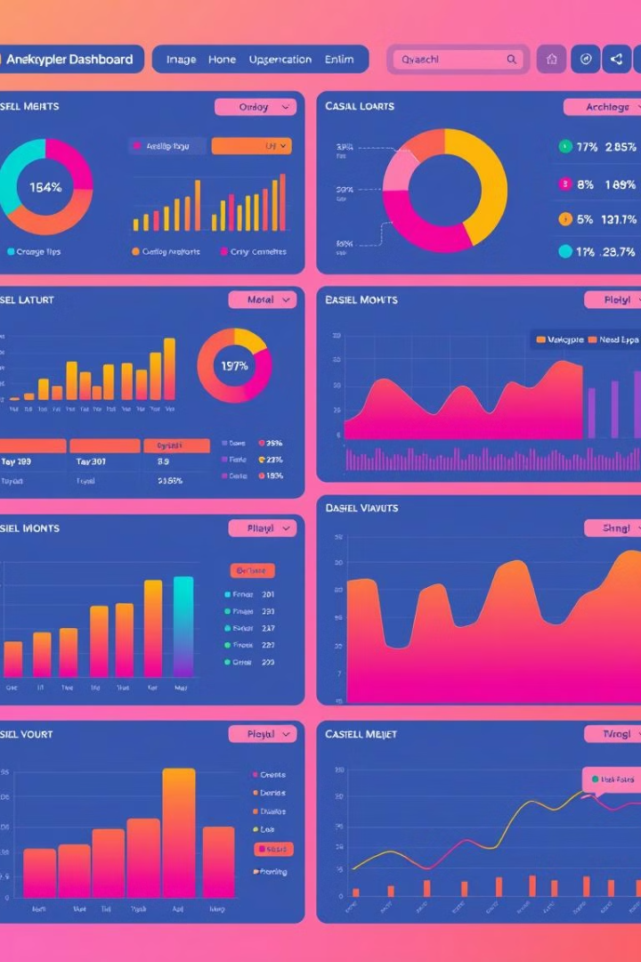
Measuring Success
100%
Transparency
We'll provide regular reports on the performance of your campaigns, ensuring you have clear insights into your online marketing efforts.
100%
Data-Driven Strategies
We'll use data to optimize your campaigns and make data-driven decisions, ensuring we are always moving in the right direction.

Slide 6
Expanding Your Reach
Paid Advertising
Influencer Marketing
International Digital Marketing
We'll leverage paid advertising platforms like Google Ads and Facebook Ads to reach your target audience and increase your online visibility.
We'll partner with relevant influencers to promote your business, tapping into their existing audience and building brand trust.
We'll help you reach international markets, translating your website and marketing materials into the target language.

Slide 7
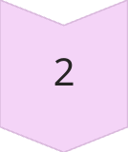
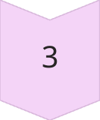
Beyond the Basics
Customer Relationship Management (CRM)
We'll help you build a robust CRM system, managing customer interactions, improving customer retention, and increasing revenue.
Mobile App Development
We'll develop a custom mobile app for your business, enhancing customer engagement, driving sales, and extending your reach.
Growth Hacking Strategies
We'll employ innovative growth hacking techniques to rapidly grow your online audience and increase your brand's influence.

Slide 8
Partnering for Success
Let's collaborate to achieve your digital marketing goals. We're excited to help you grow your business and achieve new heights.

